Slide 1
OER Leadership IMPACTcommunity

Slide 2
Polling Question 1
Tell us about you!

Slide 3
Welcome!
Maria Fieth, MA₂, RTC
Partnership Development
California State University, Office of the Chancellor
SkillsCommons and MERLOT Projects
mfieth@calstate.edu
Support@SkillsCommons.org
webmaster@MERLOT.org

Slide 4
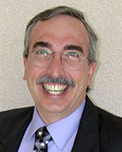
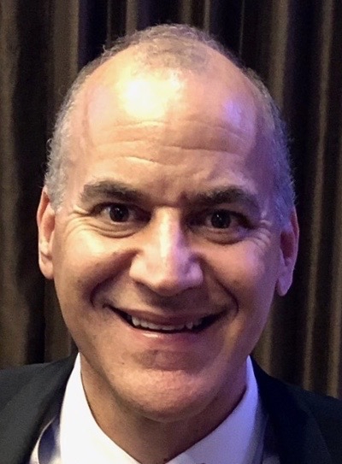
Gerry Hanley
Director, CSULB Center for Usability in Design and Accessibility (CUDA)
Executive Director, MERLOT and SkillsCommons
Professor of Psychology
Department of Psychology
California State University, Long Beach
gerry.hanley@csulb.edu
Rick Lumadue (1.800.RickLumadue)
Senior Manager
California State University, Office of the Chancellor
SkillsCommons and MERLOT Projects
rlumadue@calstate.edu
Notes:
Terri

Slide 5
Polling Question 2
Tell us about your needs in
affordable learning solutions.

Slide 6
Polling Question 3
Tell us about your
interest areas regarding
affordable learning solutions!

Slide 7
Our Next Community Gathering
Wednesday, January 22, 2019
1:00 – 2:00 pm ET
Same Zoom Connection

Slide 8
Follow Us!
Stay Current! Follow Us on Social Media!
www.skillscommons.org/Facebook
bit.ly/merlot-facebook
www.twitter.com/SkillsCommons
bit.ly/merlot-twitter(@MERLOTorg)
www.linkedin.com/company/6650163
bit.ly/merlot-linkedin

Slide 9
Let’s talk more!
"CSU MERLOT/SkillsCommons Presentations" by CSU MERLOT/SkillsCommons Team, SkillsCommons and MERLOT Projects, California State University, Chancellor's Office is licensed under CC BY 4.0 / A derivative from the original work
mfieth@calstate.edu
Connect@SkillsCommons.org
webmaster@MERLOT.org

